Slide 1
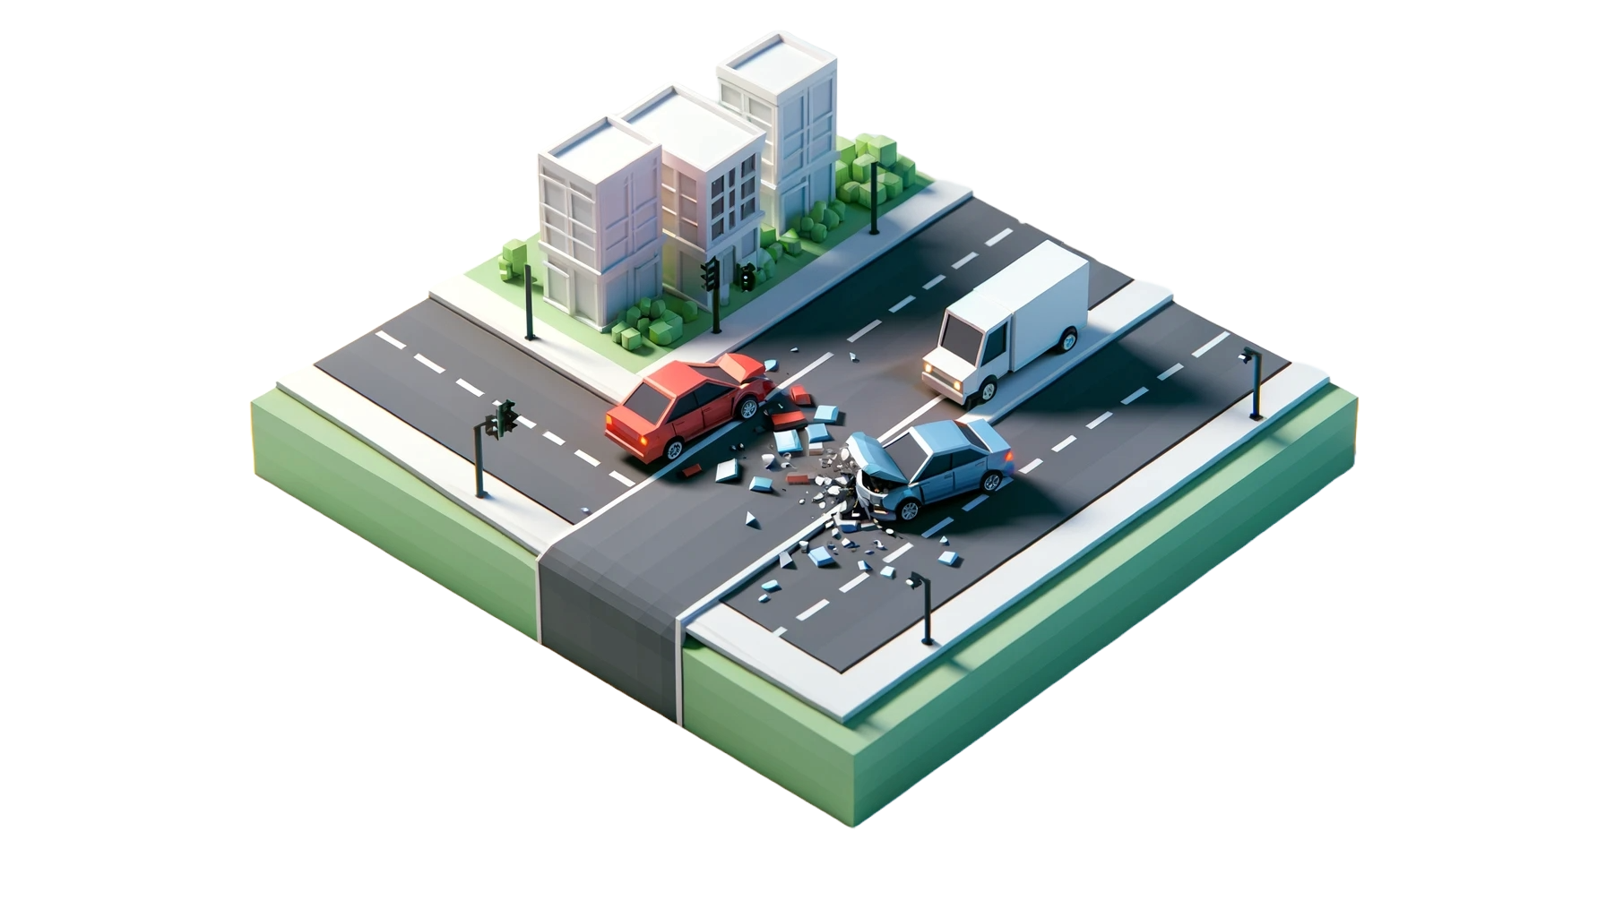
Traffic Crashes — Crashes
By: Kevin Cheung, Sidney Mei, Tony Cao
Group Name: The Tree Friends
Notes:
We are The Tree Friends.
We’re working with the Traffic Crashes - Crashes dataset

Slide 2
Dataset, Cleaning, & Transformations
Data Provided by the City of Chicago.
768,535 Rows
49 Columns
Location
Time
Conditions
Crash Specifics
Injuries
Administrative Records
Removal of:
Administrative Records
(e.g. crash_record_id)
Columns Missing ≥3%
(e.g. hit_run_i, lane_cnt)
Rows Missing Any Data
Transformations using:
Aggregation of Necessary Columns
(e.g. crash_date for crashes per day, police beats for location)
Notes:
Using Traffic Crashes - Crashes. Roughly 770K Rows, each of which, is a specific crash record.
49 Columns, covering aspects on location and time, conditions, crash specifics, injuries, and administrative records.
We started cleaning the data by removing the administrative records.
We removed all columns that were missing 3% or more of data.
Removed rows missing any data.
We aggregated the columns based on specific needs, such as the crash_date for temporal data and police beats to group crashes into territories.

Slide 3
Goals
Analyze the temporal distribution of crashes.
Examine the environmental and infrastructural factors affecting crashes.
Identify hotspots using locational data.
Understand the relationship between causes and injuries.
Notes:
The goals of our visualizations were to cover the most important aspects of the dataset pertaining to each of domain questions defined in assignment 1.
By which, they are to:
- Analyze the temporal distribution of crashes.
- Examine environmental and infrastructural factors affecting crashes.
- Identify hotspots using locational data.
- Understand the relationship between causes and injuries.

Slide 4
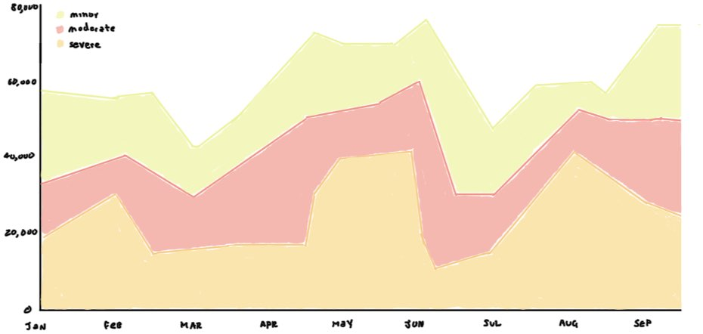
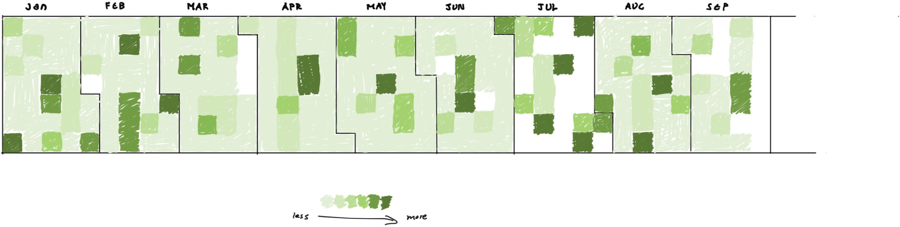
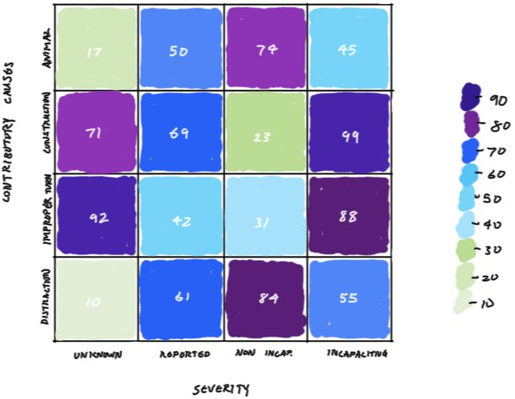
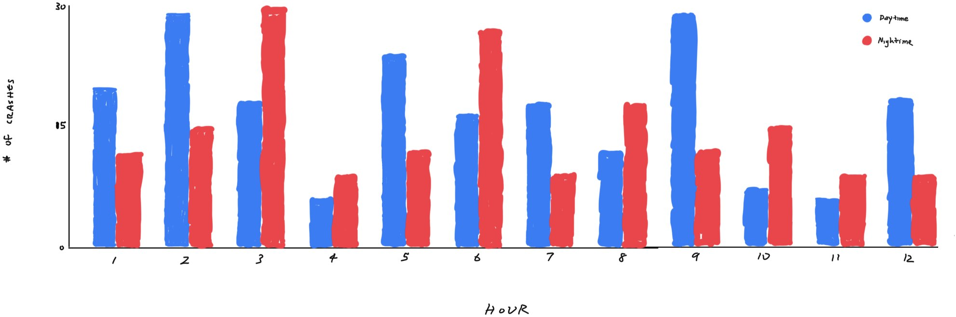
Sketches
Stacked Area Chart
Calendar Heatmap
Heatmap
Double Time Bar Graph
Notes:
Each one of our sketches focuses on the abstract goals based on our initial domain questions.
The double time bar graph, calendar heatmap, and stacked area chart are all used to analyze the temporal distribution of crashes in different ways.
On the other hand, the heatmap highlights the correlation between two causes and the types of injuries sustained.
To tailor these sketches to our questions, some of our key design decisions were to:
- use colors to highlight the number of crashes, for the severity levels of the stacked area chart, and the periods of the double time bar graph.
- use lines (bars) to show differences in crash frequencies using varying vertical lengths.
We felt that the use of heatmaps would make it easy for the viewer to recognise patterns simply on the intensity of colors.
Similarly, the use of color applies to the distinguishability between categories in the other sketch types.

Slide 5
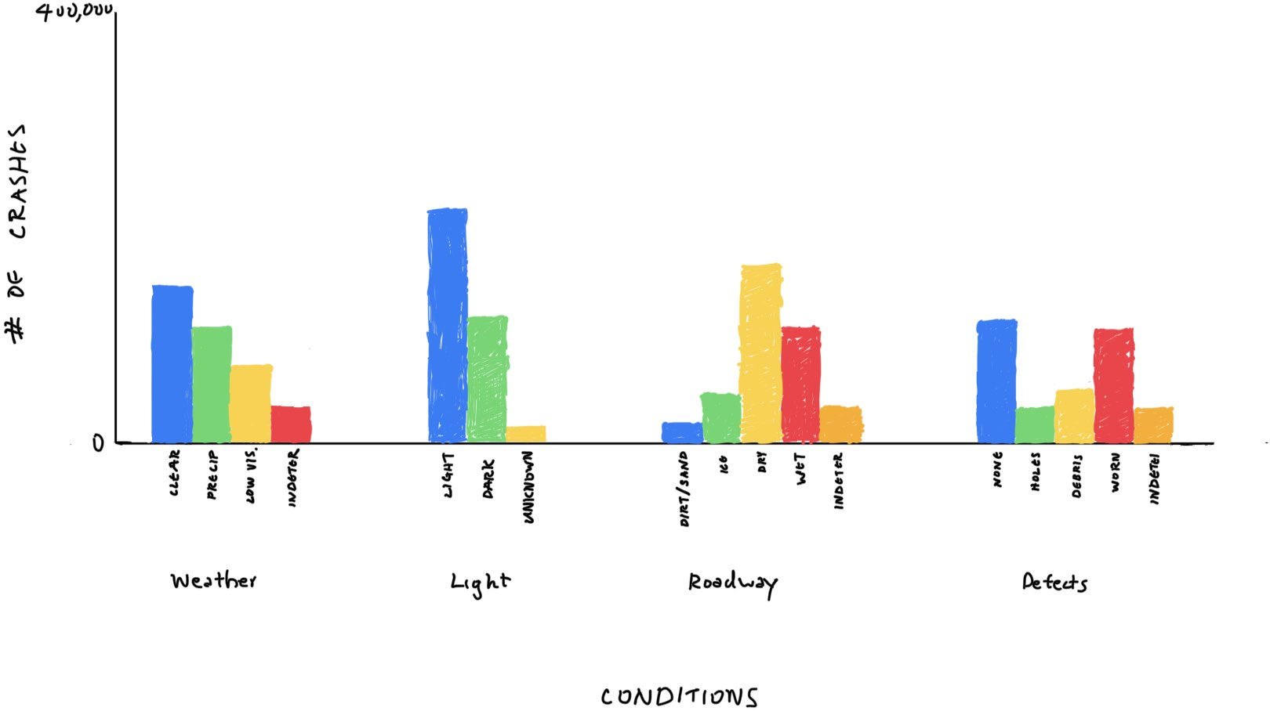
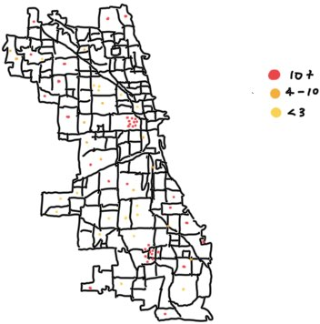
Sketches - cont.
Dot Density Map
Grouped Bar Graph
Notes:
- Our grouped bar graph follows the same logic of using color hues as maps for different categories. Each group for a different environmental or infrastructural condition (weather condition, light condition, roadway condition, and road defects). It follows the use of lines with varying vertical lengths as mentioned before.
- For the dot density heatmap, we opted to use a map to highlight the hotspots throughout the city. Points would be placed at specific crash locations with a variety of colors to intuitively indicate the number of crashes with the use of a legend.

Slide 6
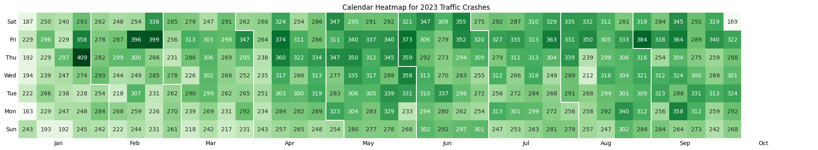
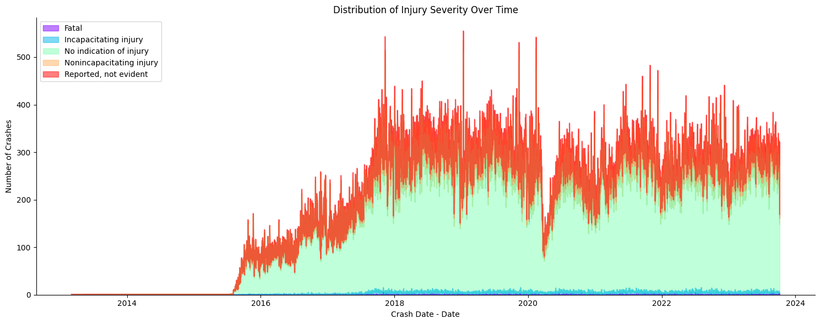
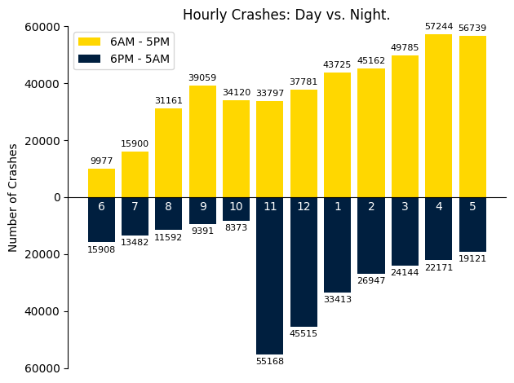
Visualizations
Notes:
In developing our visualizations, we aimed to stay true to the original sketches presented.
For the encodings of the visualizations shown,
- We are specifically using color saturation to highlight the differences in the number of crashes and color hues for categorical representations such as different injury severities and periods in the day.
- We used a bar graph which uses length to represent the differences crashes over time periods as they start from a common baseline.
- On the other hand, we were able to use areas to highlight the data through larger time frames like the months in the heatmap and to visualize the total distribution of injuries over time.
The design choices behind the visualizations are fundamentally those of the sketches, with the use of colors and some refinements for better clarity.
All of our heatmaps, on this slide and the next, have been modified to include labels to better highlight details, such as, the number of crashes. the weekdays or hours, or coordinates.

Slide 7
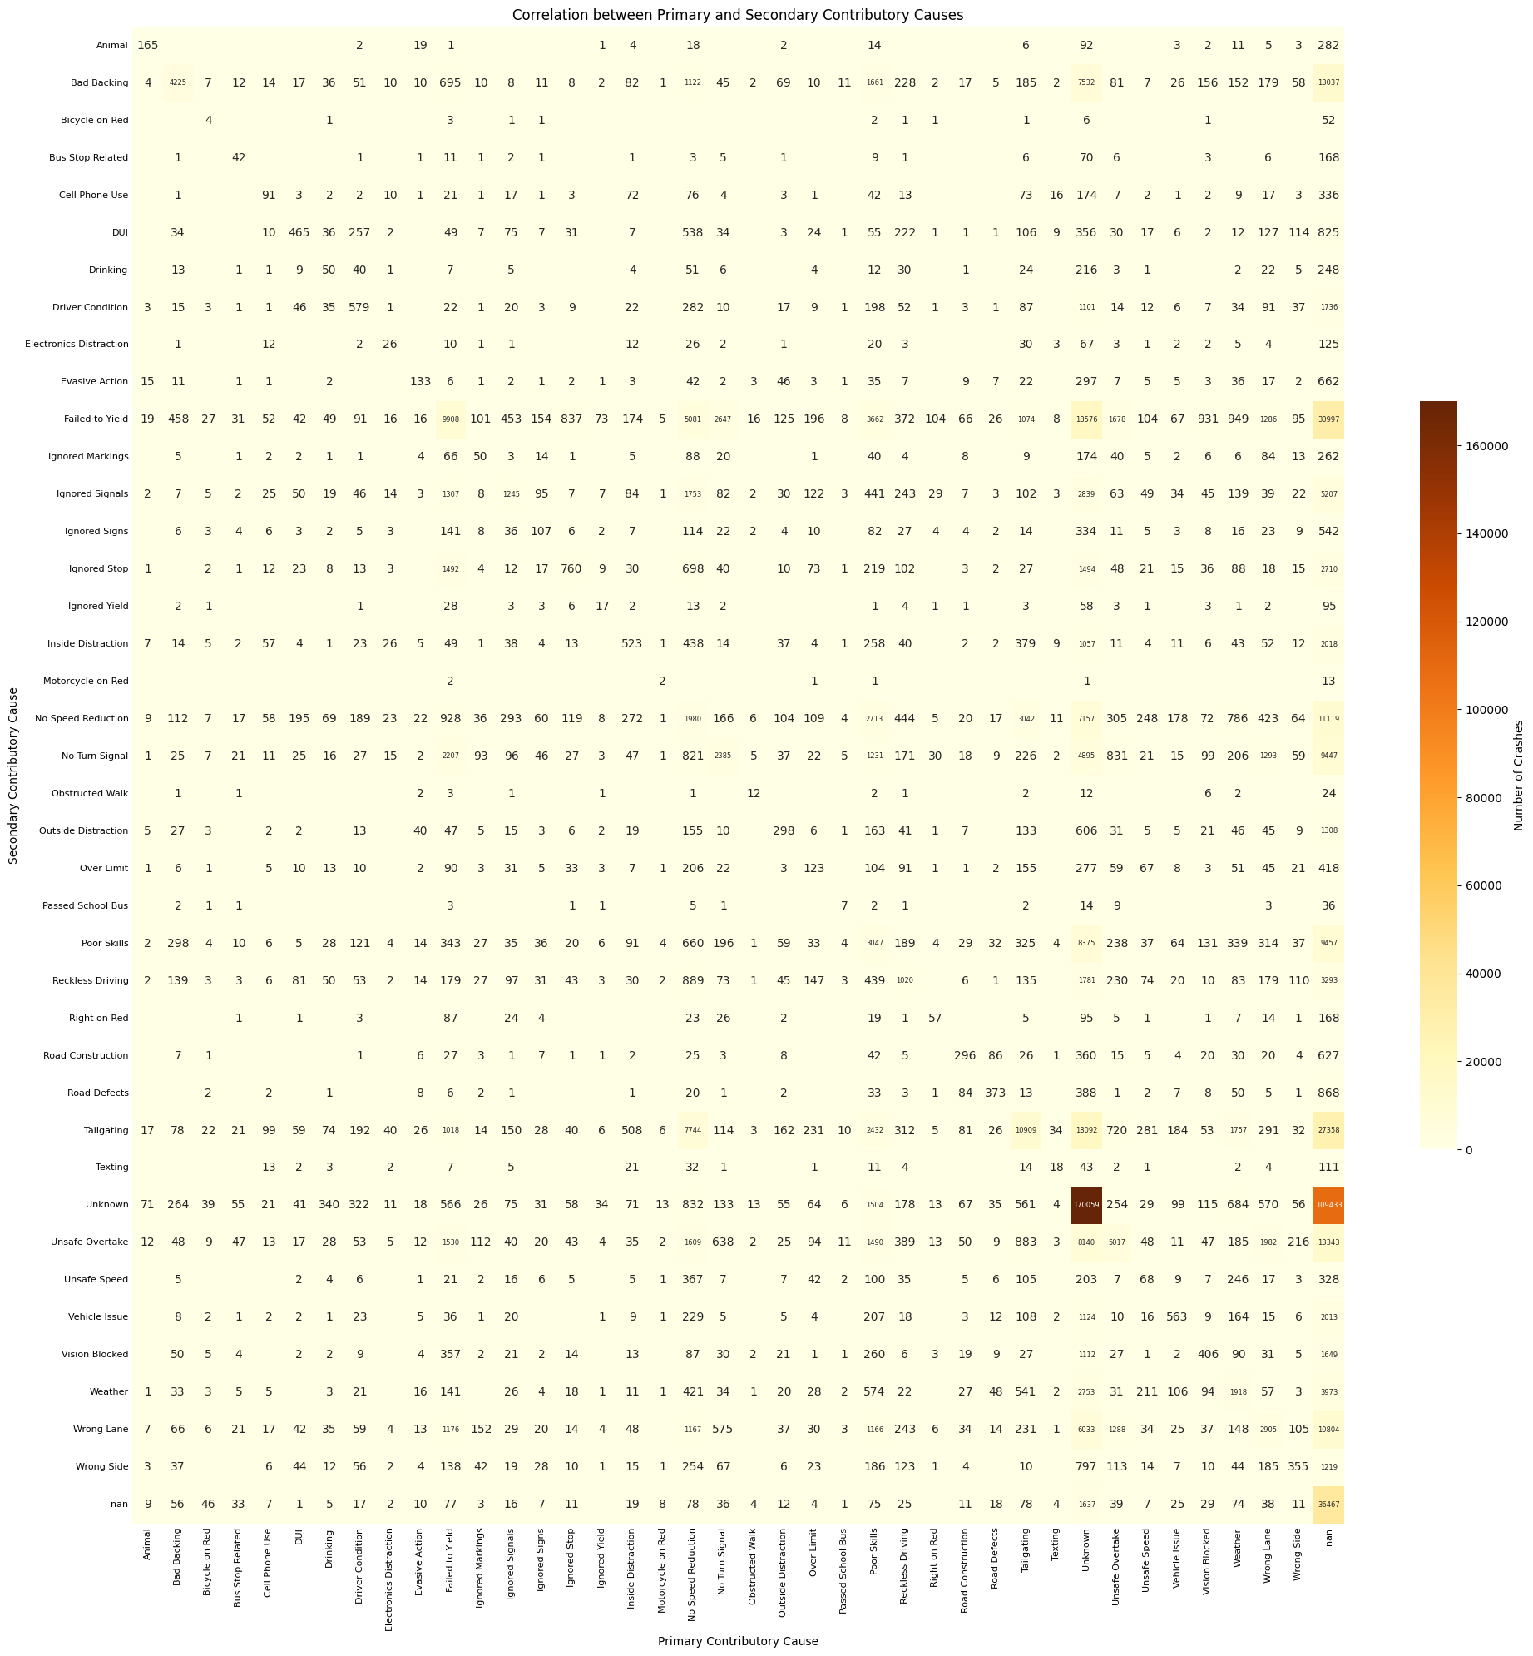
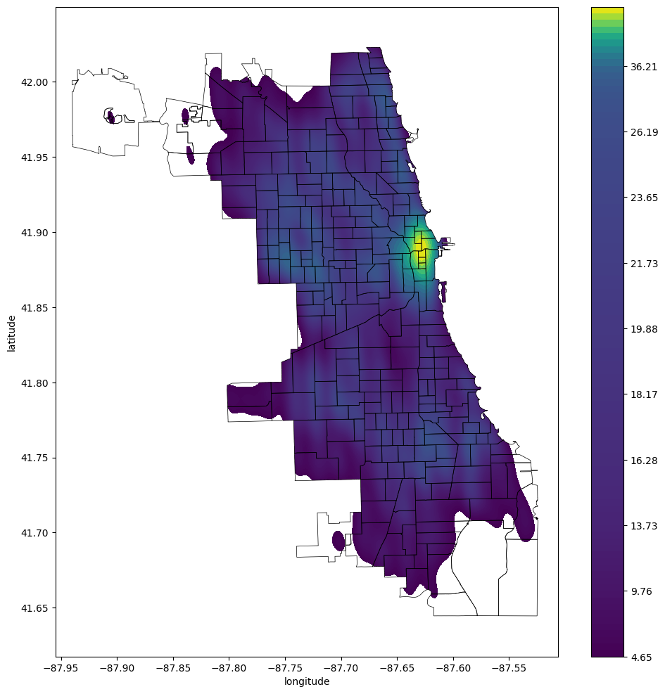
Visualizations - cont.
Notes:
For these two heatmaps, we used differences in color hues and saturations to represent the number of crashes.
Based on our initial exploratory data analysis, we found the labels for the causal categories to be too long so we shortened them.
Additionally, we found that we could incorporate the use of police beats to capture 2D-areas during our initial exploration. We modified the representation from points to a take up an area in a fluid shape in the form where the color encompassing an area represents the density of crashes.

Slide 8
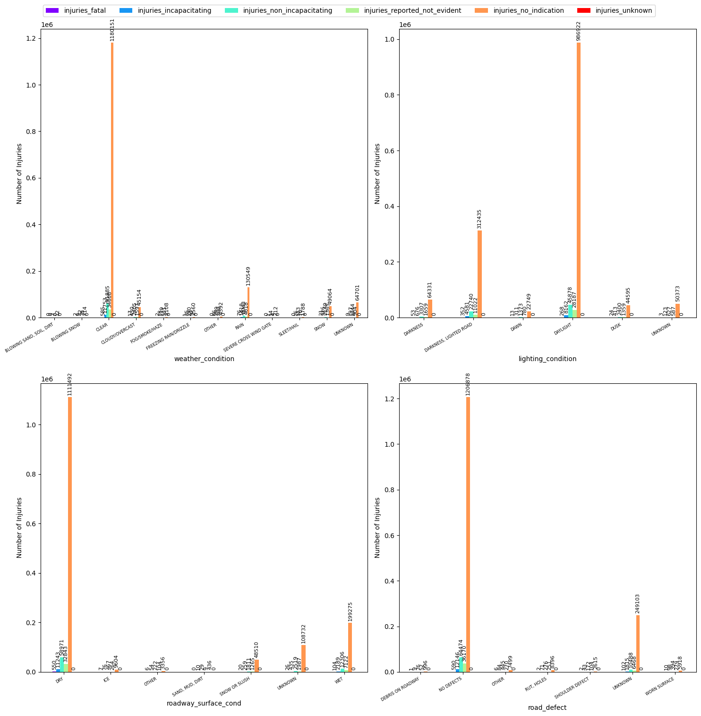
Visualizations
- cont.
Notes:
Our final visualization correlates to the grouped bar graph from our sketches and follows many of the design choices and visual encodings from that.
However, we expanded it to incorporate parts from multiple domains, namely the examination of factors leading to crashes and the relationship to injuries.
As a result, we have a grouped bar graph for each environmental or infrastructural factor.

